Slide 1
ASSIGNMENT 1:WORKING WITH TOPO SURVEY POINTS
GROUP MEMBERS:
Mary Wairimu. ESEM/01557/2021
Billy Otieno. ESEM/01672/2019
Mary Chebet ESEM/01558/2021
Alvin Wachira ESEM/01538/2021

Slide 2
INTRODUCTION
The objective of this assignment is to utilize Quantum GIS (QGIS) software to analyze and visualize topographic survey data, demonstrating key GIS techniques and cartographic skills. The project involves working with survey points provided in an Excel file to create meaningful spatial representations, including contour lines, TIN (Triangulated Irregular Network), and DTM (Digital Terrain Model) surfaces. The task also emphasizes the importance of data organization, symbolization, and map layout preparation. By exporting maps in appropriate formats and documenting the process, this report aims to highlight the practical application of QGIS in generating high-quality geospatial outputs while addressing challenges encountered during the workflow

Slide 3
OBJECTIVES
.To explore data
.To organize the data
.To symbolize the data
.To create surfaces (Contours,DSM,DTM,TIN)
.To prepare map layout

Slide 4
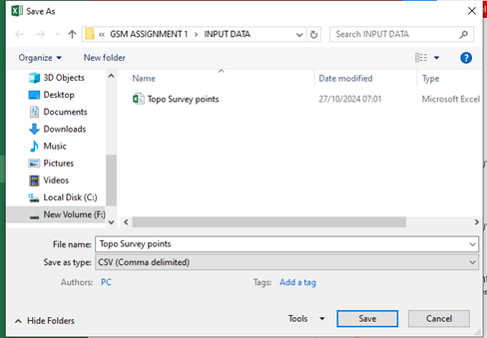
METHODOLOGY
Open the excel file appreciate the data then save it in csv in the working folder.

Slide 5
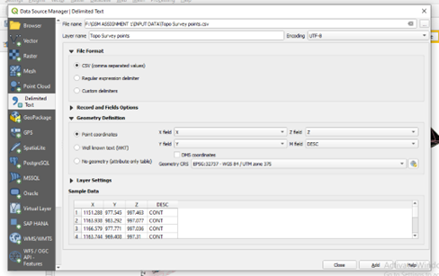
2.Add the layer by going to add layer>add delimited text layer>select the saved csv excel file >select csv format>select geometry attributes>select the correct crs and add.

Slide 6
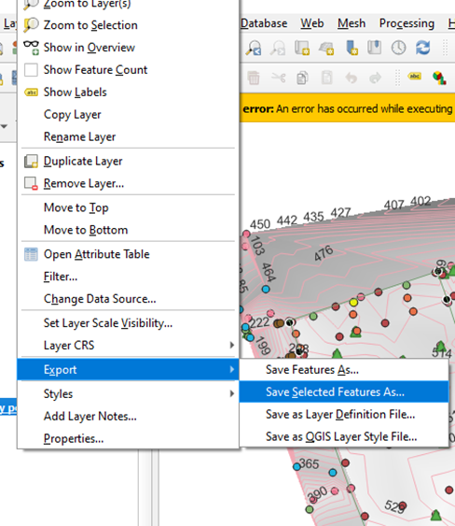
3.Right click the topo survey points layer , click open attribute table, select individual features and save as shapefiles in the export option.

Slide 7
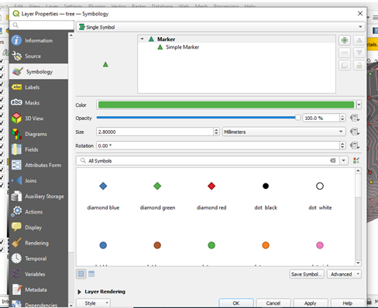
4 Right click on the saved features go to properties and symbolize appropriately.

Slide 8
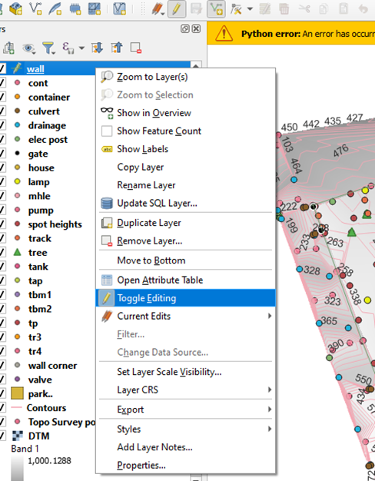
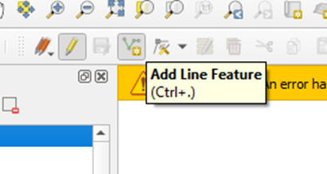
5.Convert wall,and road edge into line features and the park into a polygon by digitizing.This is achieved by right clicking the point feature>select toggle editing>select the editing tool add line /polygon feature and start digitizing.

Slide 9
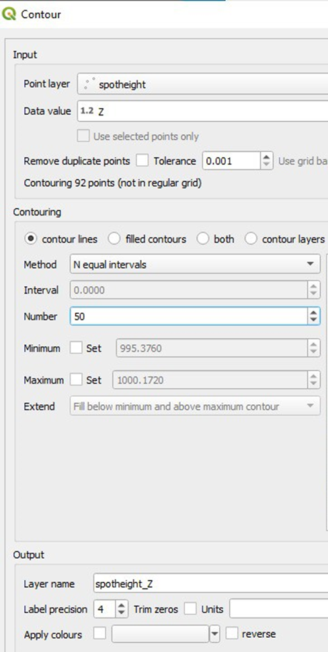
6.Create contours by selecting the contour plug-in>select the correct parameters>save it to the output folder and then run the Finally add labels in properties,

Slide 10
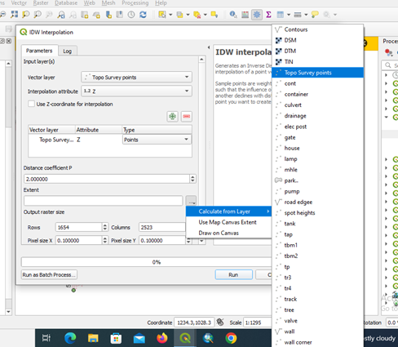
7.Create DSM by loading the interpolation tool >select IDW>select the correct parameters including the extent>save the file in output folder and run the tool.

Slide 11
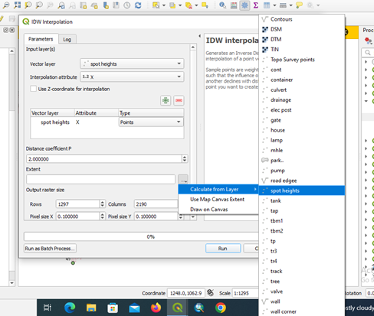
8.Create DTM by loading the interpolation tool>select IDW interpolation>select the correct parameters including the extent which is spot heights>save the file in output folder then run the tool.

Slide 12
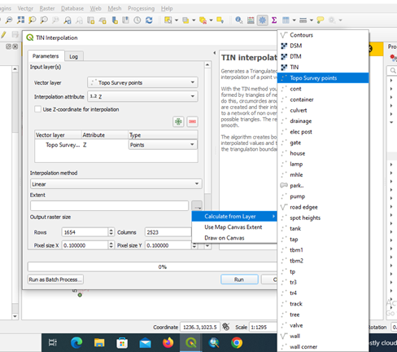
9.Create TIN by loading delauney triangle>the interpolation tool>select the correct parameters including the extent>save the file in output folder then run the tool.

Slide 13
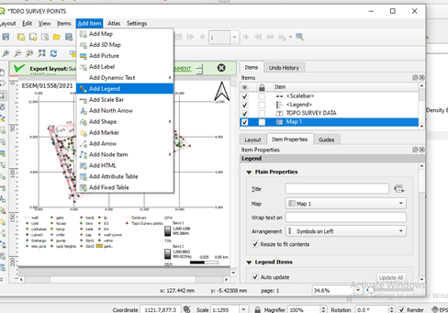
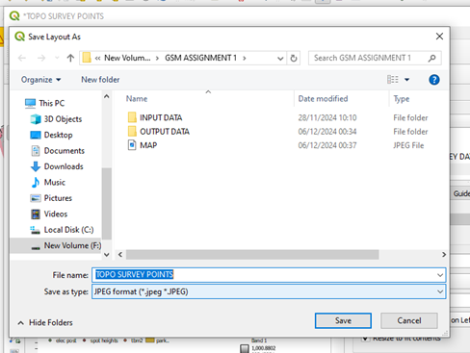
10.Prepare the map layout by clicking new map layout>add all the map elements legend,nort North arrow,title and scale bar.. Export map as jpeg.

Slide 14
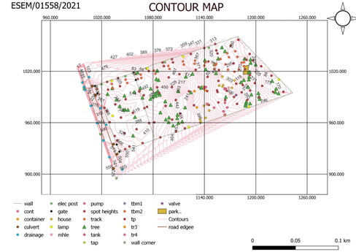
RESULTS
Contour Map.

Slide 15
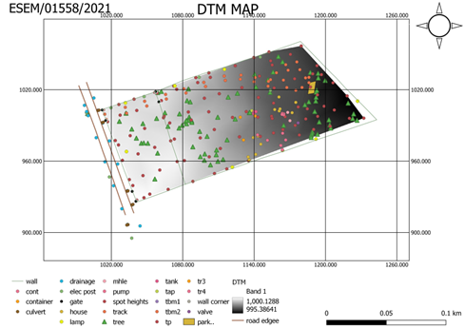
DTM Map

Slide 16
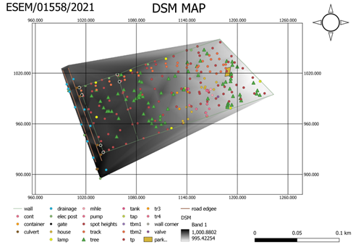
DSM Map.

Slide 17
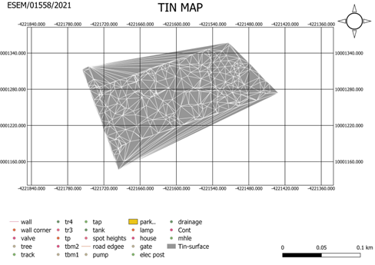
TIN Map.

Slide 18
CHALLENGES
-Contour plugin was difficult to find.
-Selecting the appropriate parameters for interpolation tool was challenging.
CONCLUSION
In conclusion This assignment demonstrated the effective use of QGIS in handling topographic survey data, from organizing data, symbolizing, labeling and generating map outputs. Key deliverables included creating contours, TIN, and DTM surfaces, symbolizing data appropriately, and designing a professional map layout with essential cartographic elements.
Through this process, I gained practical skills in surface generation spatial visualization, and exporting maps in formats suitable for various applications despite the challenges.

